Slide 1
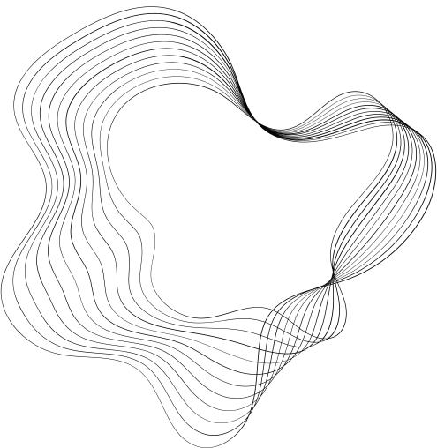

LAKSHITHA.A.D
FINAL PROJECT

Slide 2
PROJECT TITLE
Conditional Image Generation with VAEs and Generative Adversarial Networks

Slide 3
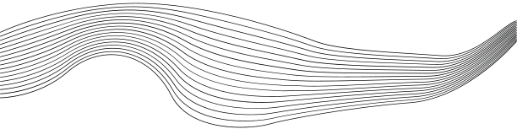
AGENDA
01
PROBLEM STATEMENT
02
PROJECT REVIEW
03
WHO ARE THE END USERS
04
YOUR SOLUTION AND ITS VALUE PROPOSITION
05
THE WOW IN YOUR SOLUTION
06
MODELLING
07
RESULTS

Slide 4
PROBLEM STATEMENT
Problem:
Generating realistic images with specific attributes or conditions is challenging due to the complex nature of image data and the inherent variability in visual features.
Algorithm Used:
We employ Variational Autoencoders (VAEs) and Generative Adversarial Networks (GANs) to address this challenge.

Slide 5
Why We Want to Solve the Problem:
Data Augmentation: It enables the generation of additional data samples for training, which is particularly useful in scenarios with limited labeled data.
Customization and Personalization: The ability to generate images with specific attributes allows for customization and personalization in various domains, such as fashion, interior design, and digital art.

Slide 6
PROJECT OVEREVIEW
1.Understanding Techniques:
We will begin by understanding the fundamentals of VAEs and GANs, including their architectures and training procedures.
We will then delve into conditional image generation and its importance in various applications.
2. Implementation:
Hands-on sessions will be conducted to implement conditional image generation using VAEs and GANs.
Participants will learn to code and experiment with different conditional inputs to generate images based on specific criteria.

Slide 7
WHO ARE THE END USERS?
Medical Professionals
Educators and Student
Industry Professionals
Software Developers
Researchers and Academics
Artists and Designers
General Public

Slide 8
YOUR SOLUTION AND ITS VALUE PROPOSITION
SOLUTION:
Our project focuses on leveraging Variational Autoencoders (VAEs) and Generative Adversarial Networks (GANs) for conditional image generation. By employing advanced machine learning techniques, we enable the generation of high-quality images that meet specific conditions or attributes defined by the user.

Slide 9
VALUES:
Customized Image Generation: Our solution empowers users to generate images tailored to their specific needs and preferences. Whether it's generating images of particular objects, scenes, or styles, users have the flexibility to control various attributes of the generated images.
Enhanced Creativity and Innovation: By providing tools for conditional image generation, we foster creativity and innovation across various domains. Artists, designers, and creators can explore new possibilities for generating unique visual content, leading to the development of novel artworks, designs, and products
Educational Opportunities: Our solution provides educational opportunities for students and professionals interested in learning about advanced machine learning techniques.

Slide 10
THE WOW IN YOUR SOLUTION
Unprecedented Customization: Our solution allows users to precisely define the attributes of the images they want to generate, offering an unprecedented level of customization.
Realistic and Diverse Outputs: By leveraging the capabilities of Variational Autoencoders (VAEs) and Generative Adversarial Networks (GANs), our solution produces high-quality images that closely mimic real-world data.

Slide 11
MODELLING
Variational Autoencoders (VAEs):
Encoder: The encoder network takes input images and maps them to a latent space where each point represents a latent code encoding the image features. It incorporates convolutional layers followed by dense layers to capture hierarchical representations.
Decoder: The decoder network reconstructs the input image from the latent space representation. It decodes the latent code into an output image, utilizing transposed convolutional layers to upsample the features.

Slide 12
Generative Adversarial Networks (GANs):
Generator: The generator network synthesizes images conditioned on specific attributes or classes. It takes random noise vectors along with conditional information as input and generates images that resemble the desired class or attributes. The architecture typically comprises convolutional layers followed by upsampling layers.
Discriminator: The discriminator network discriminates between real and generated images. It takes input images (either real or generated) along with their corresponding conditional information and predicts the probability of the input being real or fake. It employs convolutional layers followed by dense layers for classification.

Slide 13
Conditional Image Generation:
We combine the VAE and GAN architectures to enable conditional image generation. This involves conditioning both the encoder and decoder of the VAE, as well as the generator and discriminator of the GAN, on specific attributes or classes.
Conditional information, such as class labels or attribute vectors, is incorporated into the networks' architectures as additional input channels or concatenated with the feature representations at various layers.

Slide 14
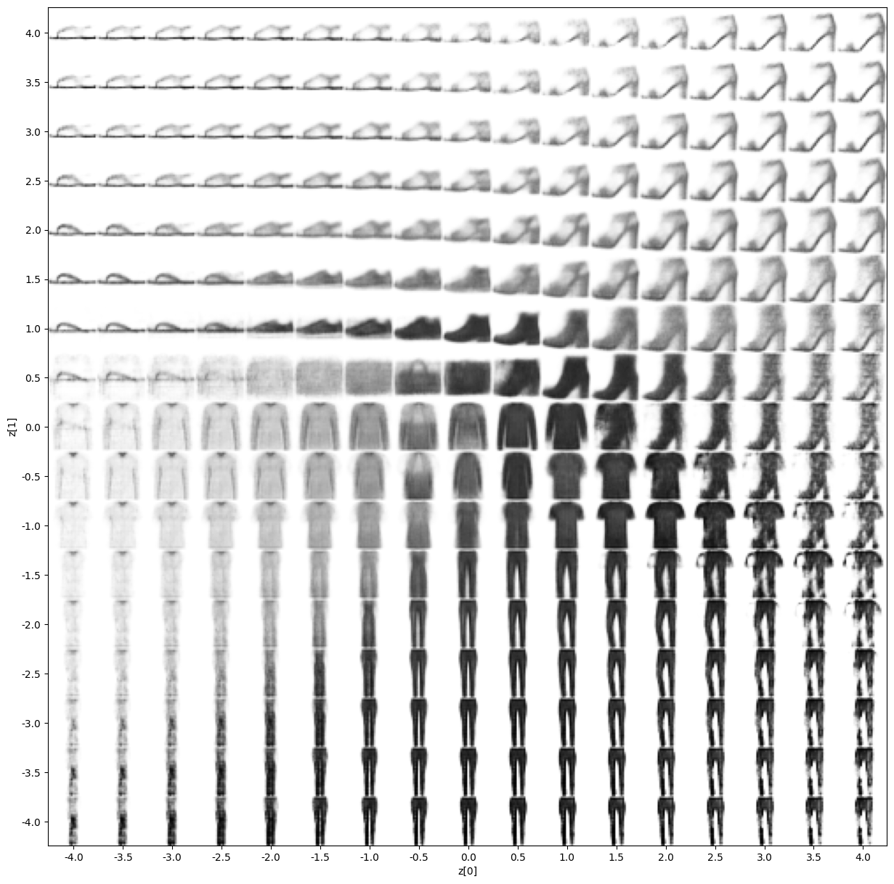
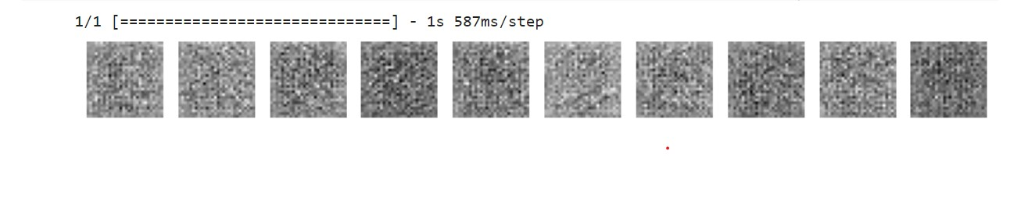
RESULT

